Slide 1
Back in my day
An exploration of history of the underground music scene in Bristol

Slide 2
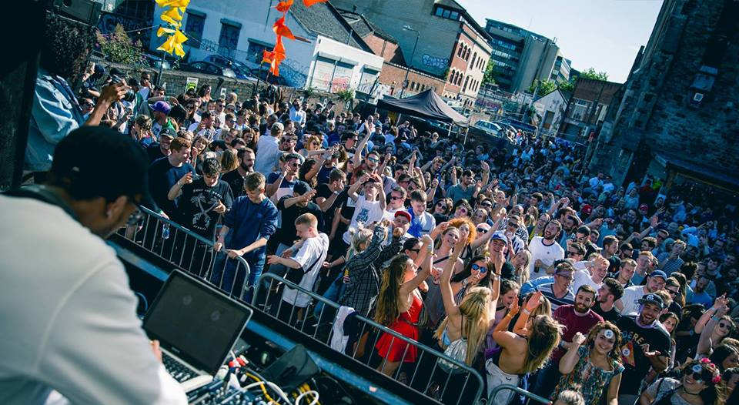
Project Outline
Based on extensive research into Bristol and the history of its music scene
This project allows the public to see inside some of Bristol’s most iconic venues from the last 30 years
All while listening to a range of songs that helped cement Bristol’s reputation in the UK music scene
In our experience, users will be able to visit
Lakota
The Trinity Centre
The Fleece
And hear music from famous Bristol based artists
Lakota carnival party 2018

Slide 3

Brief requirements
Accessible – the experience has very little user interaction but is highly immersive. The scenes are not too fantastical nor overwhelming
Art form potential – this project shows that creating experiences using music is viable. Although we have covered songs from the past, artists could use this platform for concerts or music videos
Audience research and Insight – By basing the project in Bristol, we have been able to visit locations in person and speak to people who live and breath music
Notes:
Accessibility and interaction – there is very little interaction for the player so no overwhelming controls. Users can choose which venue to visit with a ‘poster board interface’.
Art form – as we are recreating gigs, it proves that VR has a potential as an art form. Not only are we playing music, but there are some considerations towards stage lighting as well as in game characters reacting to the music as if it were a real concert – combing audio and visual elements.
Audience research and insight – we reached out and interviewed local experts to work out what venues, genres and artists we should use in our product to create an authentic experience.
Some design considerations were made based on events from the interviews. By using music from artists that no longer perform in the venues we have chosen, we’ve created an experience that some people may never experience in real life, as well as one that some people can compare to their real memories.
We aimed to reduce jerky motion to increase

Slide 4
Response to feedback
Feedback | Response
Lack of clear research into Bristol music scene. | Completed deeper research into Bristol’s music scene. Interviews were conducted.
Lack of detail for venues / artists in research. | Narrowed down music choice and decided on specific artists and tracks to fit each of the venues.
Notes:
We felt it was important to focus on improving the project based on feedback we had gotten from our client presentation. We were told that there was not enough clear research regarding the Bristol music scene, which is obviously very important considering it is an integral part of the project. So we conducted deeper research into each genre and venue, by speaking to experts and finding music that matches the chosen venues. Another consideration was the venues and artists themselves, which interviews

Slide 5
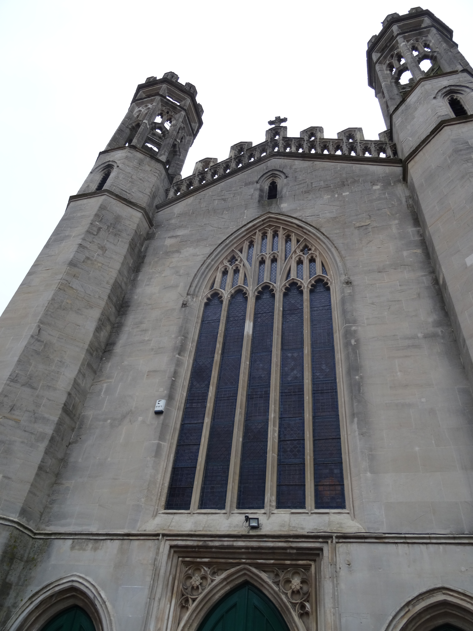
Research, interviews and project management – Mike’s contributions 16024897
Reaching out to local experts for research purposes
Stylistic choices based on research, such as:
what genres were most important to include
which venues we should model
what music to feature
Visiting venues to take reference photos
met experts for interviews
Transcribing interviews
Narrative script writing and recording
Design documentation
Notes:
Working with Connor and Pearce, I reached out to experts in Bristol who were knowledgeable about the history of music in Bristol. These include: Marti Burgess, the owner of Lakota, Adam ‘Dev’ Devonshire, bassist of Bristol band Idles and Edson Burton, the heritage and engagement coordinator at the Trinity Centre.
These interviews helped paint a picture of what the project should like and added some authenticity to the creative decisions we made, such as:
what genres were most important to include
which venues we should model
what music to feature
I also went to every venue (except Lakota – covid19) to take reference photographs which were crucial for 3D modelling
Parts of the interviews were transcribed to help write the narrative.
Plans were made to use professional recording equipment to record our narrative introductions however covid stopped access to equipment.
Scripts were written based on the interviews.

Slide 6
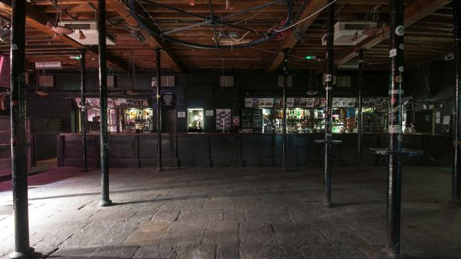
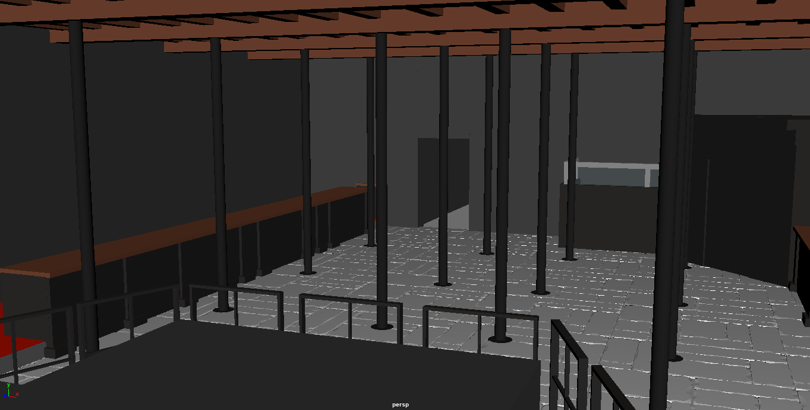
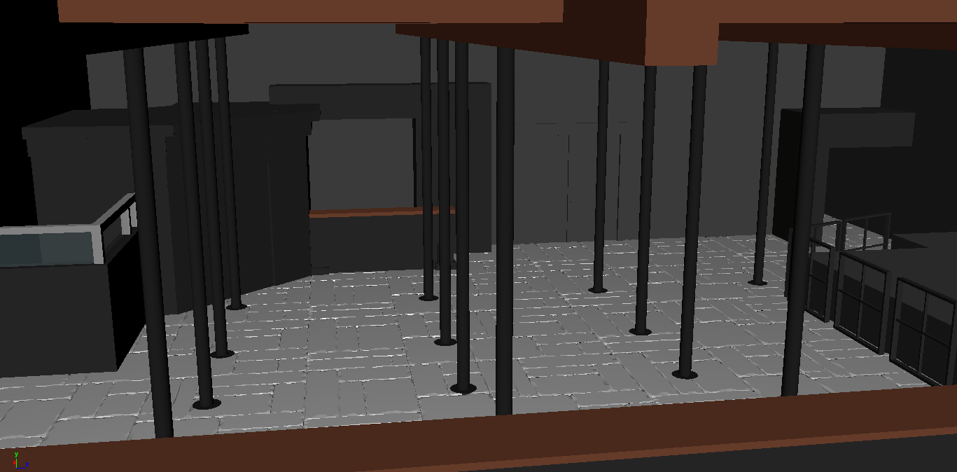
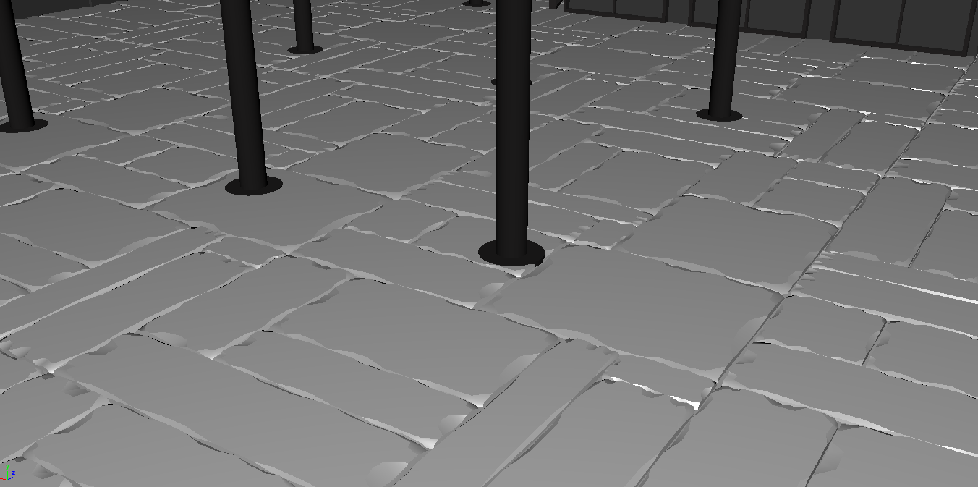
RESEARCH, INTERVIEWS, research, documentation and modelling –Pearce's CONTRIBUTIONS
Interviews- initiated contact with venues/people who have knowledge of and insight into bristol's music scene
Research- carried out research for the project, including visiting venues and sourcing out information relevant to the venues
Modelling- i used the reference photos from research to model the fleece venue in maya
Games Design Document- wrote the core sections for the gdd
Notes:
Interviews - Conducted interviews which primarily involved discussions around the Bristol music scene and its historical context. The goal of these interviews was to gain insight and knowledge surrounding the prominent genres within the city. With many of the interviews, we also found out a lot of information about the specific venues that are apart of the project. This helped us with storyboarding and scripting a great deal, because were more informed about the kind of events that actually took place.
Research- Carried out relevant research regarding the genres we displayed in the project, and also took reference photos for The Fleece.
Design documentation- Wrote the majority of the design documentation, which outlines the project.
Venue modelling- I modelled the asset used for The Fleece scene, based off of the reference photos. One of the most prominent aspects of modelling the venue was the unique stone floor.

Slide 7
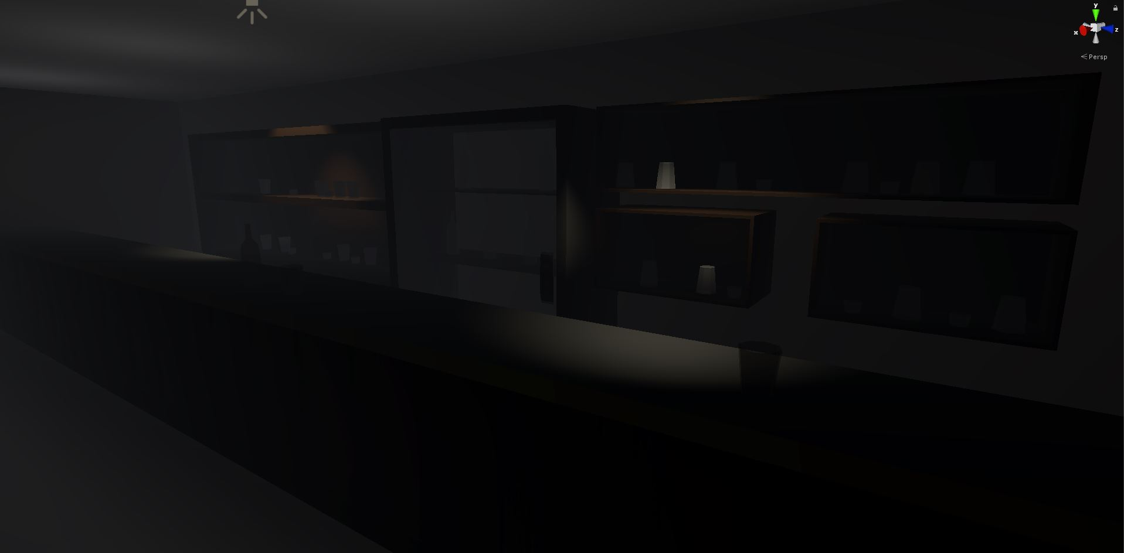
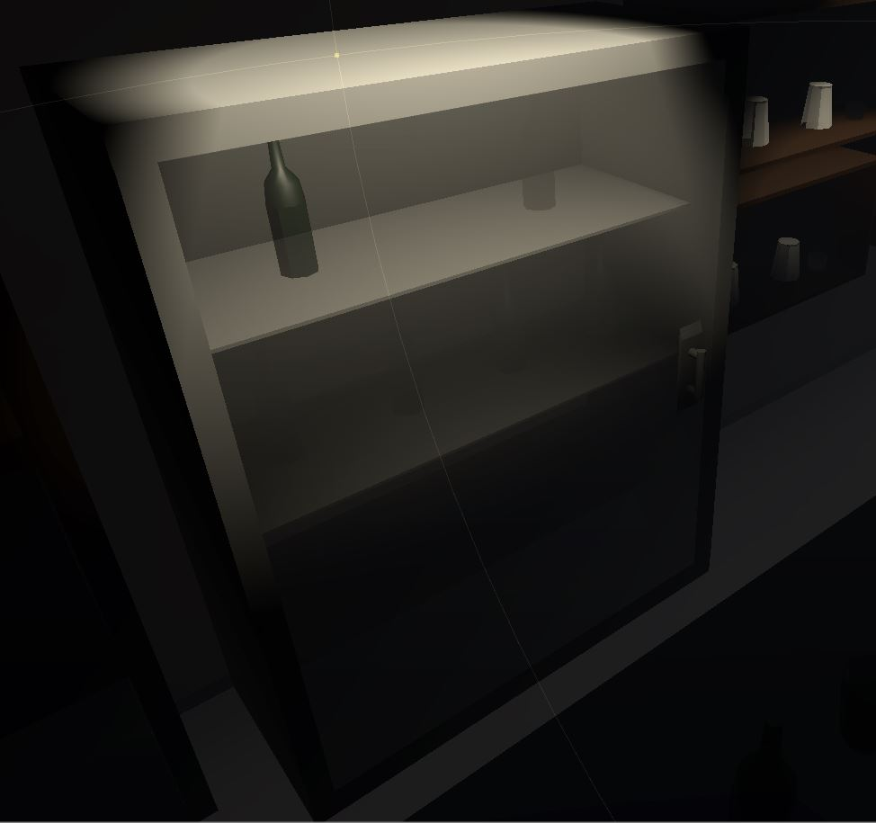
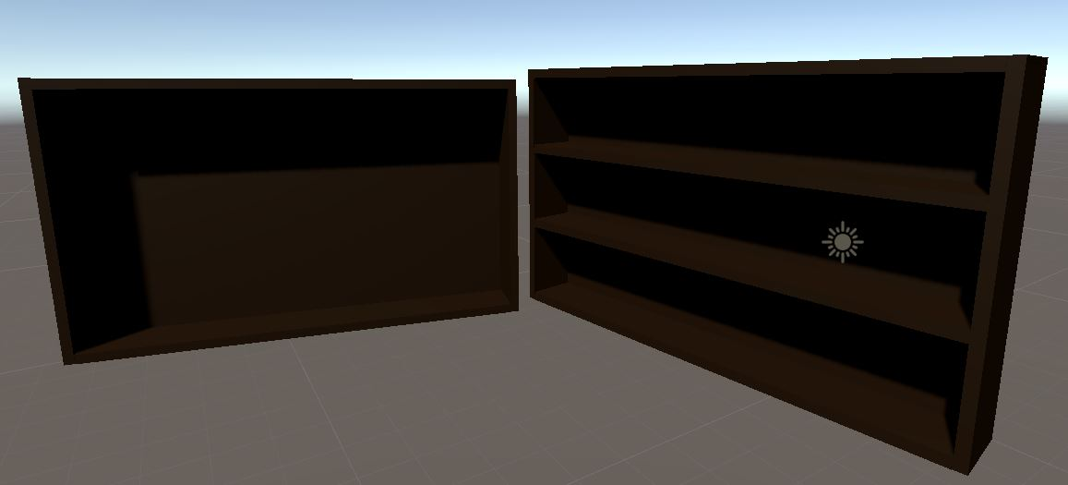
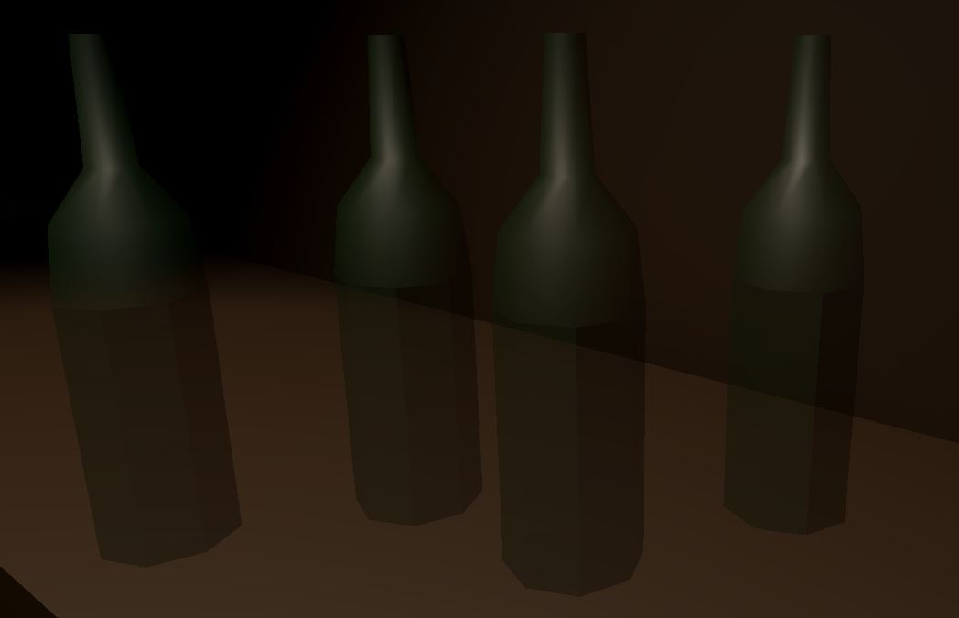
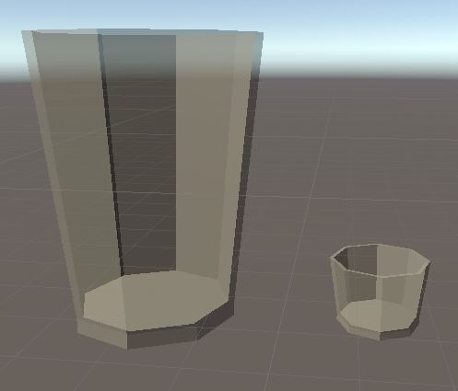
Research & Interviews, Modelling and Weekly Updates – Connor's Contribution
Research – Was part of the research team that went to different venues and met with people that were able to give information and ideas.
Weekly Log – Updated the GitHub with our weeklys doings and what needs to be done.
Modelling – Created an array of model props for the bar areas in each scene.
Notes:
Research – Conducted Research at the Trinity Centre, The Fleece and Lakota. Also spoke with Edson Burton from The Trinity Centre, Marti Burgess from Lakota and Delroy Hibbert to get as much background research as possible, which was extremely helpful. We also took many photos of each venue to reference for modelling purposes.
Modelling – Created props to be placed into each of the scenes. Used Maya to create an array of Glasses and Bottles, and a selection of different shelves and a fridge to hold bottles and drinks.
Weekly Log – Made changes to the weekly log on GitHub with what progress has been made and what will be worked on in the coming weeks.

Slide 8
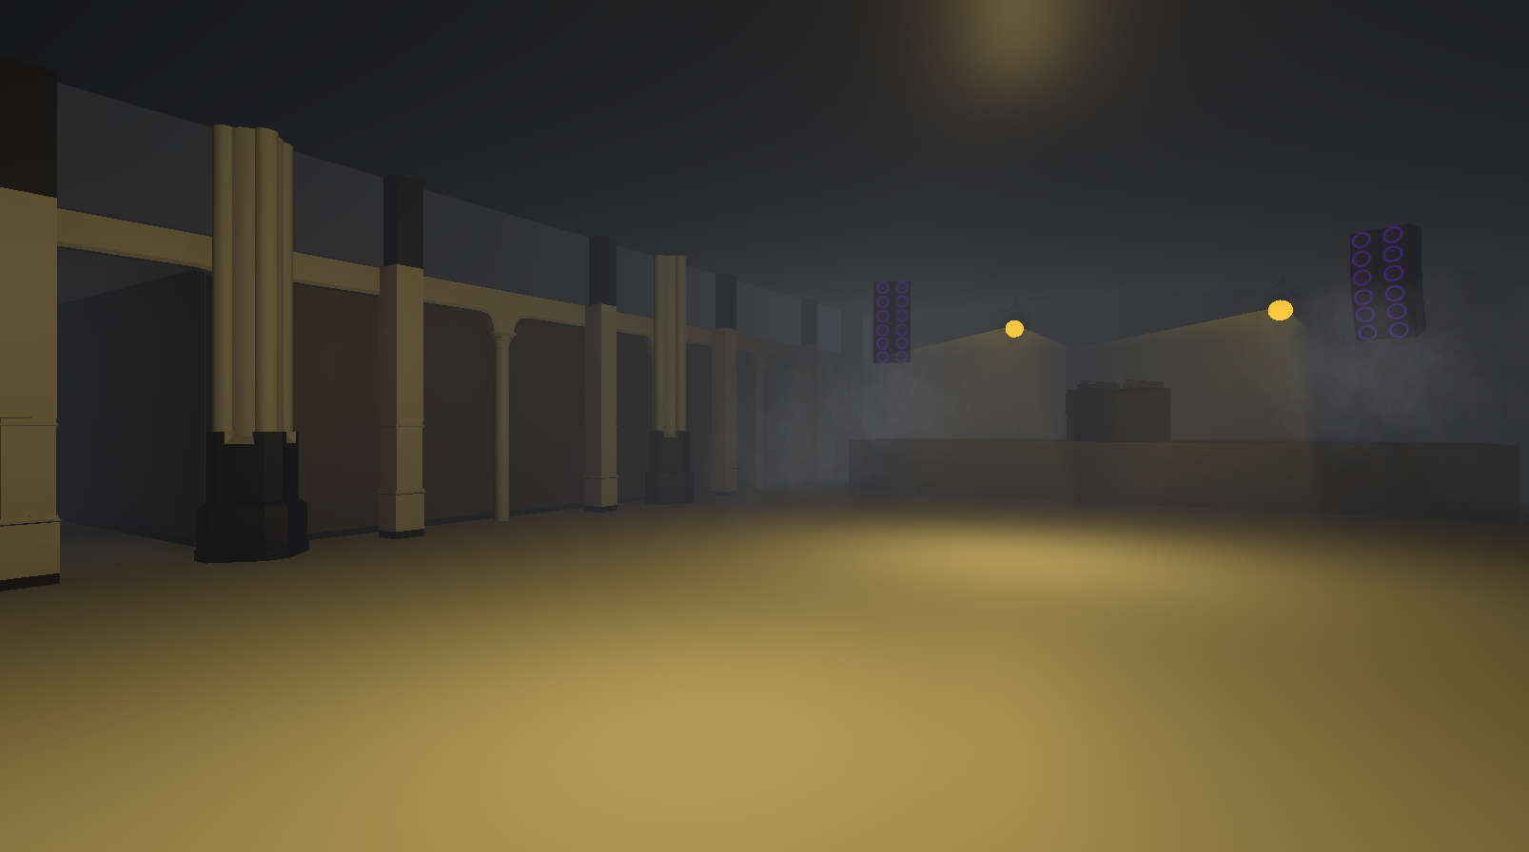
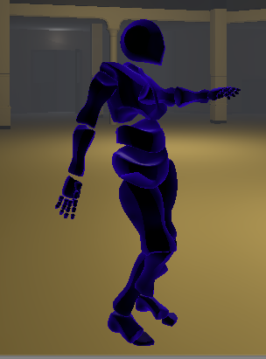
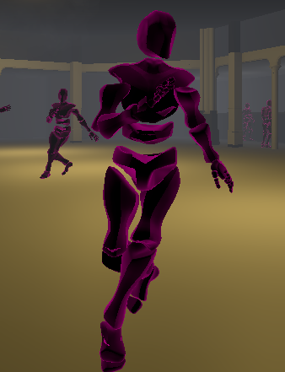
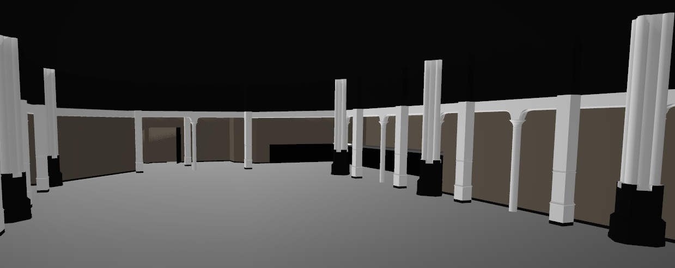
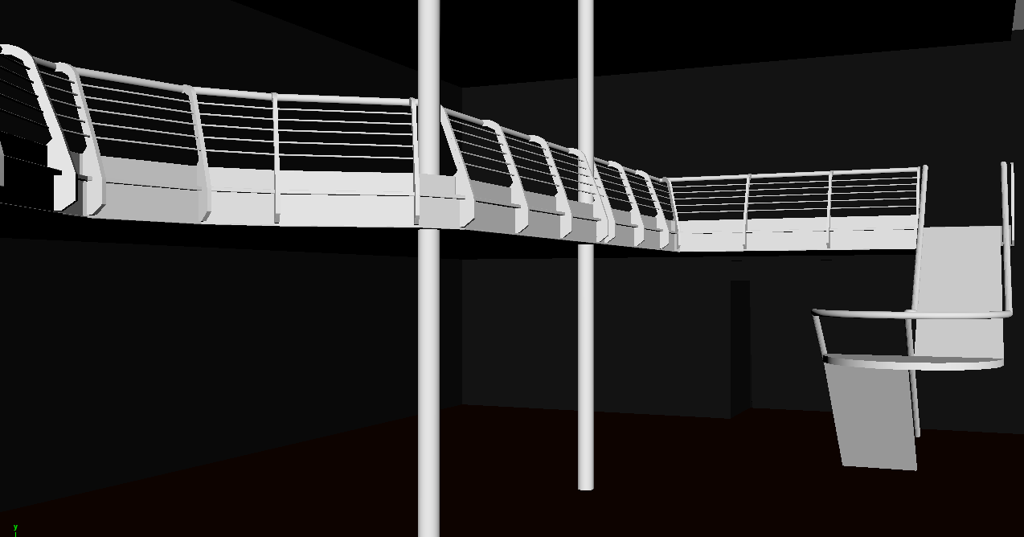
Shaders, lighting, modelling, scripting and particles –Eddie’s contribution
Modelling – Modelled the Trinity and Lakota scenes along with various props.
Shaders – Created the shaders used on the dancer characters to handle the changing of colour and fade in of opacity.
Scripting – Created scripts to handle scene transition, and scene management.
Particles – Implemented the audio responsive particles.
Lighting - Handled baking of static lights and timings of dynamic lights in the scenes.
Notes:
I modelled the Trinity and Lakota scenes along with various props, including speakers, spotlights and DJ turntables.
A shader is applied to all of the characters in the scene that makes their colour change continuously. The shader also allows for the characters’ opacity to fade in when the scenes begin and back out when the scene ends.
I set up the scripts for the timing for th
We incorporated a beat detection script to map ,

Slide 9
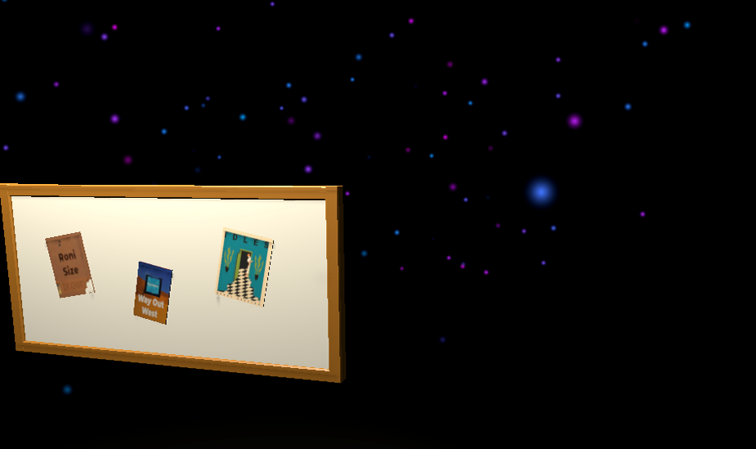
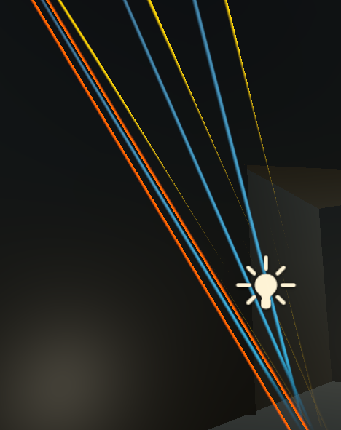
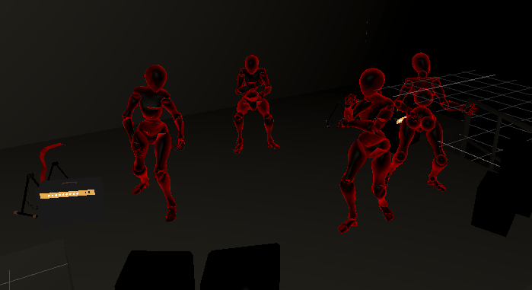
Animations, props, Modelling, scripting and particle effects – Harry's Contribution
Technical – Dancing actors and animations. Created shader graphs and Line renderers for the disco lights.
Modelled the menu scene and various props. As well as populating each venue props to add life.
scripted the boiler-plate code for the timings of the events during the venue scenes.
Created particle systems such as Smoke and lasers. and assisted in early iterations of the of the particle systems for the dancing actors.
Notes:
I modelled and designed the Menu scene and the Posters/Posterboard for the scene selection.
Added most the small items and props around the bars,
Added all the dancing actors and stage Performers in each scene. I Used mixamo.com for all the animations and tried my best to vary the animations depending on the scene and music playing for each scene.
Assisted Eddie with scripting by coding all of the boiler plate code to time and organize the events in scene such as dancers and music fading in, the lights turning on etc.
Created various particle effects and Shader graphs for some of the smoke and lazers effects.

Slide 10
Thank you

